Slide 1
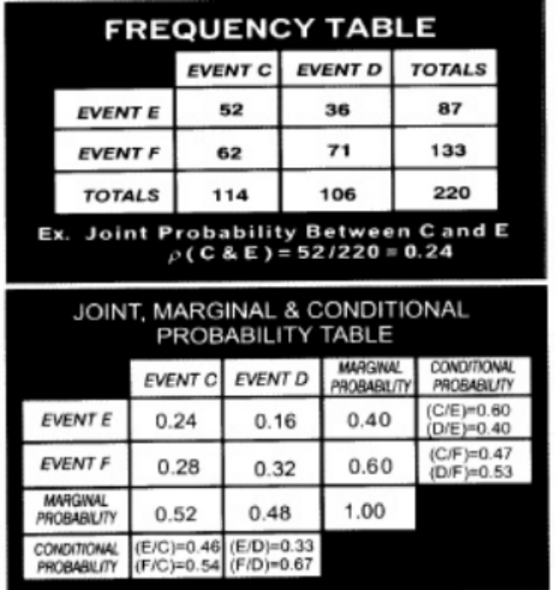

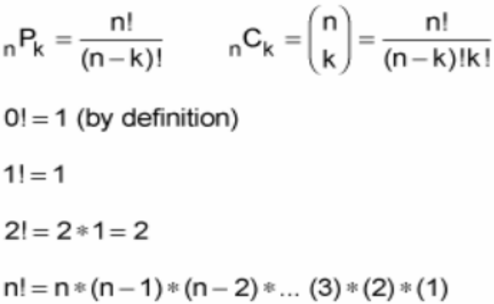
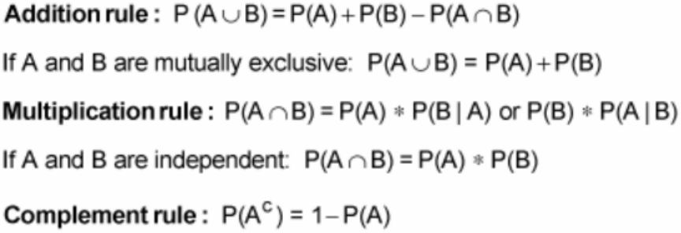
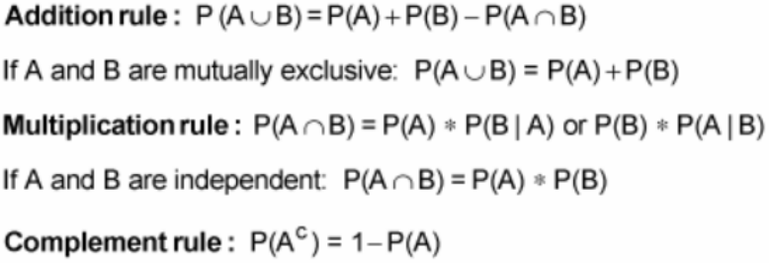
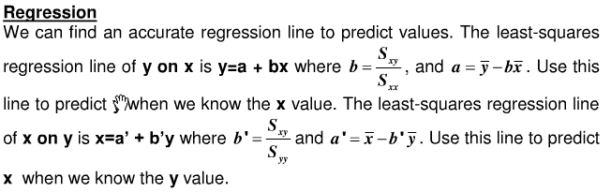
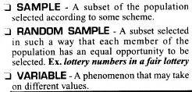
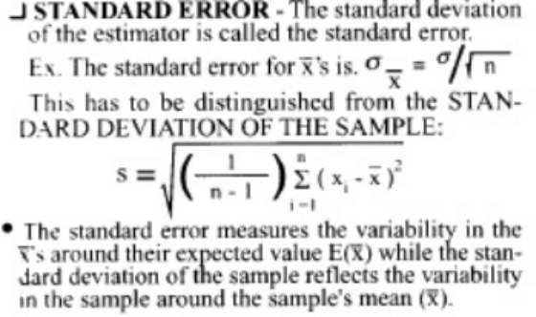
A sample space Ω is the set of all possible outcomes of a random experiment
An event E is a subset of the sample space. E1=(1,2,3) E2=(2,4,6) E3=(5)
The COMPLEMENT of E (i.e. not E) everything in that is outside of E, written as E^{C}
The UNION ∪ or/both P(E1 ∪ E2) true if either E1OR E2 or BOTH is true…so P(E1 ∪ E2) = 1,2,3,4,6
The INTERSECTION ∩ and P(E1 ∩ E2) The probability of E1 And E2 occurring… P(E1 ∩ E2) = 2
can also express as P(E1 ∩ E2) = P(E1) _x0002_x P(E2 | E1)
DISJOINT if intersection of P(E1 ∩ E2) = Ø (empty set)
CONDITIONAL probability, (E2 | E1) or P_{E1}(E2) What is the probability of a E2 given (i.e., conditioned on) E1?” rewritten as P(E2 | E1) = P(E2 ∩ E1) / P(E1)
INDEPENDENCE Two events, E1 and E2, are independent if and only if PE1(E2) = P(E2). That is, knowing that E1 occurs doesn't give us any information about whether E2 will occur. Implication: If E1 and E2 are independent, then P(E1 ∩ E2) = P(E1) _x0002_x P(E2)
1. NONNEGATIVITY: P(E) _x0015_≥ 0 for any event
2. DISJOINT ADDITIVITY: If E1 and E2 are disjoint, then P(E1 [ E2) = P(E1)+P(E2)
3. Unity of the Sample Space: P(Ω ) = 1
4. The Complement Rule: P(E^{C}) = 1- P(E)
5. Probability of General Unions: P(E1 ∪ E2) = P(E1) + P(E2) - P(E1 ∩ E2)
Axioms of Probability
You are the owner of an electronics store in a small town in a remote part of Cochise County, AZ. Based on data from a store in a similarly sized town in a neighboring county, you estimate that the number of plasma televisions sold in a given day can be described by the following probability distribution:
Prob. rules
Compute the mean and standard deviation of the distribution of TVs sold per day.
numTVs = 0:9 probs = c(0.05, 0.01, 0.1, 0.2, 0.1, 0.05, 0.3, 0.1, 0.05, 0.04)
(meanTVs = sum(numTVs * probs)) = 4.72
(sdTVs = sqrt(sum(((numTVs - meanTVs)^2) * probs))) = 2.218468
Use the sample() function in R to simulate (i) a day, (ii) a week, (iii) a (30-day) month and (iv) a (non-leap) year of TV buying. We assume that days are independent with respect to TV sales.
(day = sample(numTVs, 1, replace = TRUE, prob = probs)) = 6
(week = sample(numTVs, 7, replace = TRUE, prob = probs)) = 2 3 3 2 9 6 3
sleep=c(3,9,2,6,5) error=c(5,1,11,6,7)
----------------------------------------
# Cross-Product
> (sleep-mean(sleep))*(error-mean(error))
2 -20 -15 0 0
# Sum of Cross-Product
> sum((sleep-mean(sleep))*(error-mean(error)))
-33

Slide 2
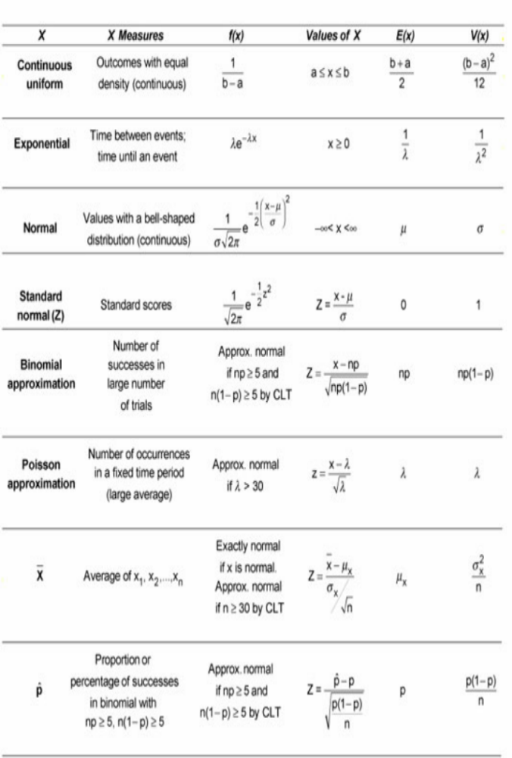
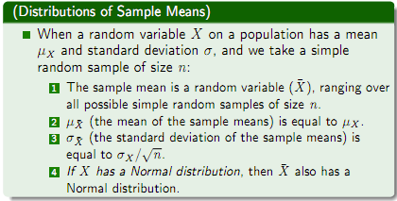
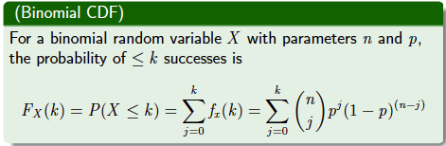
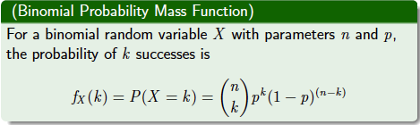
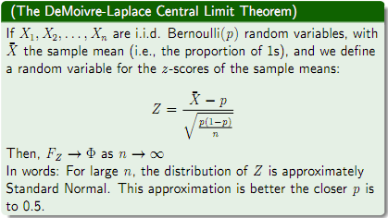
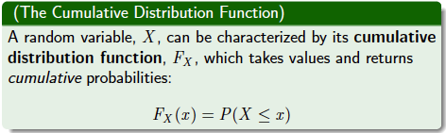
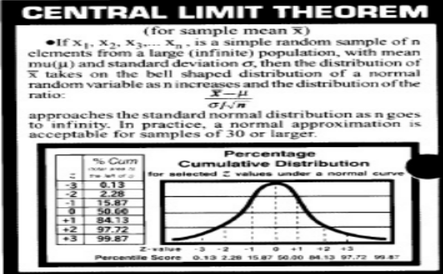
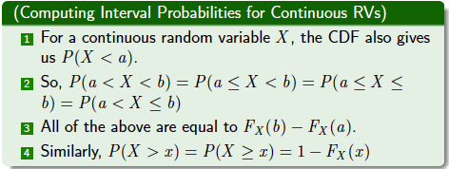
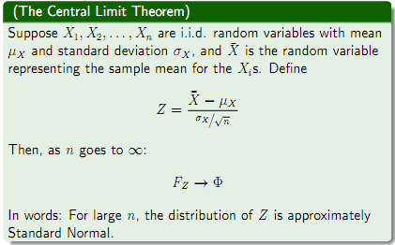
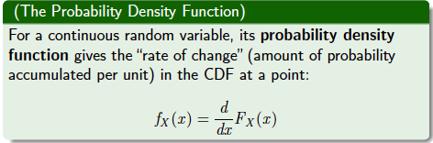
Continuous Probability Distributions When you work with continuous probability distributions, the functions can take many forms. When you work with the normal distribution, you need to keep in mind that it's a continuous distribution, not a discrete one. A continuous distribution's probability function takes the form of a continuous curve, and its random variable takes on an uncountably infinite number of possible values.
Discrete Probability DistributionsIn probability, a discrete distribution has either a finite or a countably infinite number of possible values. That means you can enumerate or make a listing of all possible values, such as 1, 2, 3, 4, 5, 6 or 1, 2, 3, . . .There are several kinds of discrete probability distributions, including discrete uniform, binomial
The standard deviation of the
sampling distribution of sums
δ * √n

